Slide 1
Unit V
Indexing and Searching

Slide 2
Outline
Inverted Files
Other Indices for Text
Sequential Searching
Pattern Matching
Compression

Slide 3
Introduction
First option in searching for a query is to scan the text sequentially.
Sequential or online text searching involves finding the occurrences of a pattern in a text when a text is not preprocessed.
Online search is appropriate when the text is small and volatile.
Second option is to build data structures over the text (called indices) to speed up the search.
It is useful when text is large and semi-static.
There are three main indexing techniques:
Inverted files
Suffix arrays
Signature Files

Slide 4
Inverted Files
An inverted file (or inverted index) is a word-oriented mechanism for indexing a text collection in order to speed up the searching task.
An inverted file Structure consist of two components
vocabulary -is the set of all different words in the text
Occurrences-for each word a list of all the text positions where the word appears is stored. The set of all those lists is called the occurrences.

Slide 5
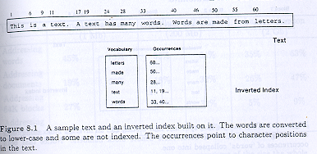

Slide 6
Inverted Files
Block addressing- is used to reduce the space requirements.
The text is divided in blocks, and the occurrences point to the blocks where the word appears.
Pointers can be smaller because there are fewer blocks than positions.
All the occurrences of a word inside a single block are collapsed to one reference.
Indices of only 5% overhead over the text size.
But if the exact occurrence positions are required, then online search over the qualifying blocks has to be performed.

Slide 7
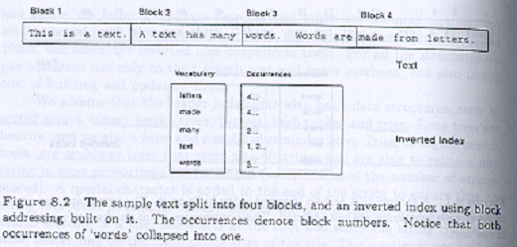

Slide 8
Inverted Files
Searching:
The search algorithm on an inverted index follow three general steps:
Vocabulary search- the words and patterns present in the query are isolated and searched in the vocabulary. Phrases and proximity queries are split into single words.
Retrieval of occurrences- The list of occurrences of all the words found are retrieved.
Manipulation of occurrences- The occurrences are processed to solve phrases, proximity, or Boolean operations. If block addressing is used it may be necessary to directly search the text to find the information missing from the occurrences.

Slide 9
Inverted Files
Construction
Split the index into two files:
In the first file i.e. Posting file：the lists of occurrences are stored contiguously.
In the second file, the vocabulary is stored in lexicographical order and points to its list.

Slide 10
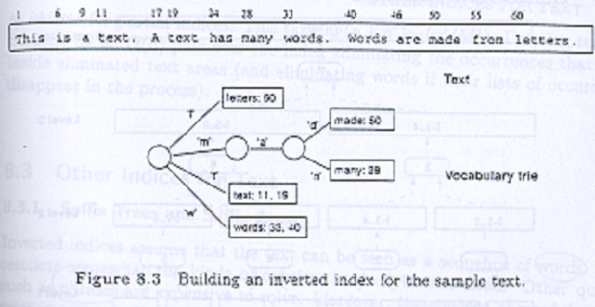

Slide 11
Inverted Files
The above algorithm is not practical for large texts where the index does not fit in the main memory.
For Large texts
Partial index
Merging two indices consists of merging the sorted vocabularies.

Slide 12
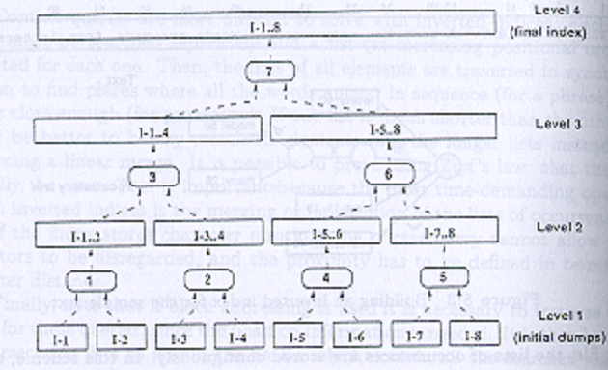

Slide 13
Other Indices for Text
Suffix Trees and Suffix Arrays
Signature Files

Slide 14
Suffix Trees and Suffix Arrays
Suffix arrays are space efficient implementation of suffix trees.
Its construction process is complex.
It is suitable for applications such as genetic databases.
This index sees the text as one long string.
Each position in the text is considered as a text suffix (a string that goes from that text position to the end of the text).
Index points are selected from the text, which point to the beginning of the text positions which will be retrievable.

Slide 15
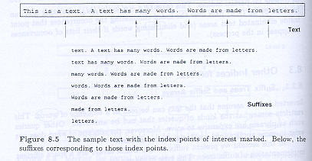

Slide 16
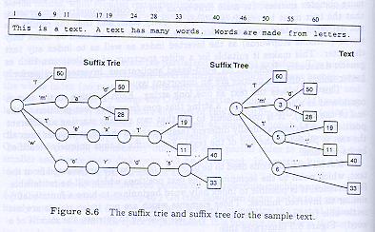

Slide 17
Suffix arrays
The main drawbacks of Suffix Array are its costly construction process.
Allow binary searches done by comparing the contents of each pointer.
Supra-indices (for large suffix array)

Slide 18
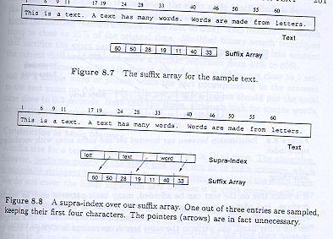

Slide 19
Signature Files
Word-oriented index structures based on hashing.
A signature file uses a hash function (or signature) that maps words to bit masks of B bits.
Divides the text in blocks of b words each.
The mask is obtained by bitwise ORing the signatures of all the words in the text block.
Searching a single word is carried out by hashing it to a bit mask W and comparing the bit masks B of all the text blocks.
If W & Bi = W, the text block may contain the word.

Slide 20
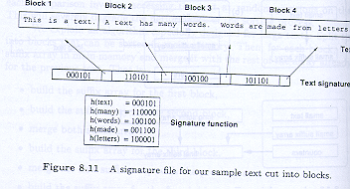

Slide 21
Boolean Queries:
Set manipulation algorithm, they are used when operating on sets of results, which is the case in Boolean Queries.
The search proceeds in three phases:
The first phase determines which documents classify.
The second determines the relevance of the classifying documents so as to present them to the user.
The final phase retrieves the exact positions of the matches to highlight them in those documents.
This scheme avoids doing unnecessary work on documents.
It is possible to evaluate the syntax tree in two forms:
Full evaluation form- both operands are first completely obtained and then the complete result is generated.
Lazy evaluation - results are delivered only when required.

Slide 22
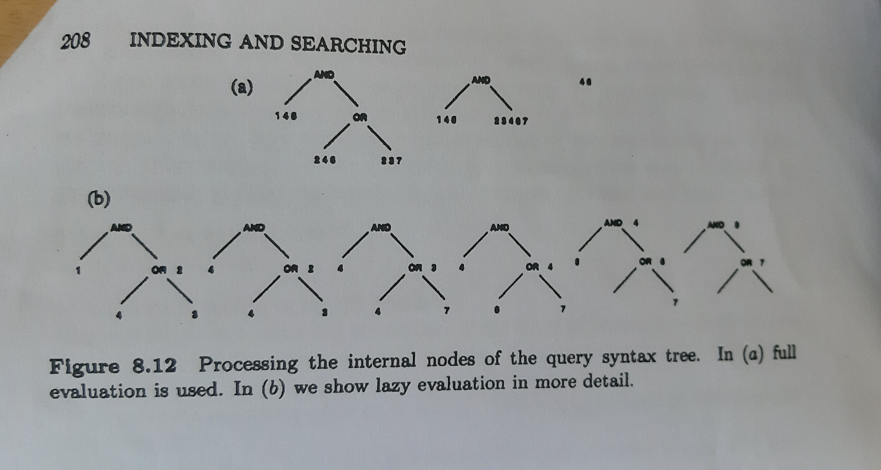

Slide 23
Sequential Searching
Brute Force
Knuth-Morris-Pratt
Boyer-Moore Family
Shift-Or
Suffix Automaton
Backward DAWG matching (BDM)
BNDM

Slide 24
Brute Force
It consist of trying all possible pattern positions in the text.
For each such position, it verifies whether the pattern matches at that position.

Slide 25
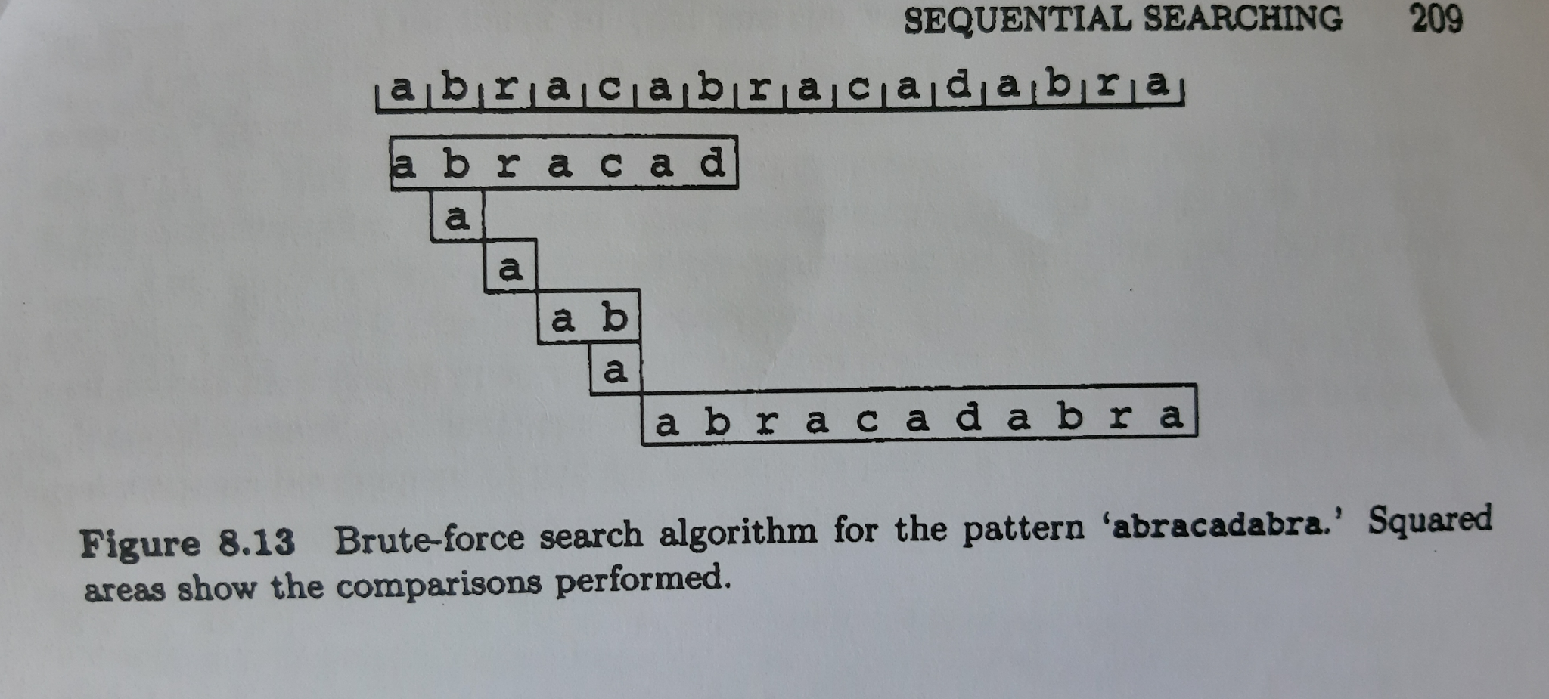
Brute Force

Slide 26
Knuth-Morris-Pratt
This algorithm also slides a window over the text.
However, it does not try all window positions, instead, it reuses information from previous checks.

Slide 27
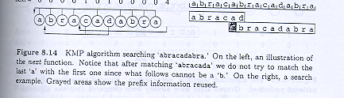
Knuth-Morris-Pratt

Slide 28
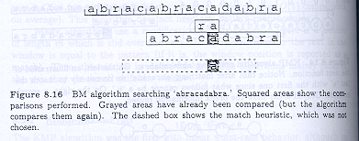
Boyer-Moore Family

Slide 29
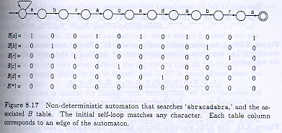
Shift-Or

Slide 30
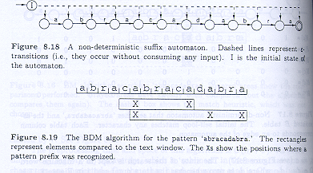
Suffix Automaton

Slide 31
Pattern Matching:
Pattern matching are the techniques to deal with complex patterns.
It is divided into two groups:
Searching allowing errors
Searching for extended patterns

Slide 32
String Matching allowing errors:
Also called approximate string matching.
Given a short pattern P of length m, a long text T of length n, and a maximum allowed number of errors k.
Find all the text positions where the pattern occurs with at most k errors.
With minimal modifications it is adopted to searching whole words matching the pattern with k errors.

Slide 33
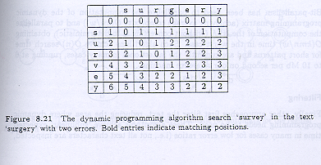
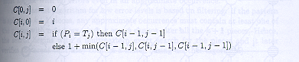
Dynamic Programming:

Slide 34
Automaton:
The problem can reduced to non-deterministic finite automaton (NFA).
Dynamic programming algorithm is used.
Bit-Parallelism:
Used to parallelize the computation of the dynamic programming matrix and to parallelize the computation of the NFA.
Achieves O(n) search time for short patterns and fastest ones in many cases.

Slide 35
Filtering:
Filters the the text first, reducing the area where dynamic programming needs to be used.
Achieves sublinear expected time in many cases for low error ratios.
Not all text characters are inspected.
Not effective for more errors.
It is based on the fact that some positions of the pattern must appear with no errors.

Slide 36
A generic Multimedia Indexing Approach:
It focus on “whole match ”queries.
For, a collection of N objects: O1,O2,.....On.
The distance between two objects (Oi, Oj) is given by the function D(Oi, Oj), which can be implemented as a program.
The user specifies a query object Q, and a tolerance E.
Goal is to find the objects in the collection that are within a distance E from the query object.
Sequential scanning is used.
Sequential scanning may be slow due to:
The distance computation might be expensive.
The database size might be huge.

Slide 37
Automatic Feature Extraction:
Algorithms for automatic feature extraction methods exist, like ‘Multidimensional Scaling’ (MDS) and ‘FastMap’.
It facilitates visual data mining: 2D or 3D projections of the data set, and inspect it for clusters, correlations and other patterns.

Slide 38
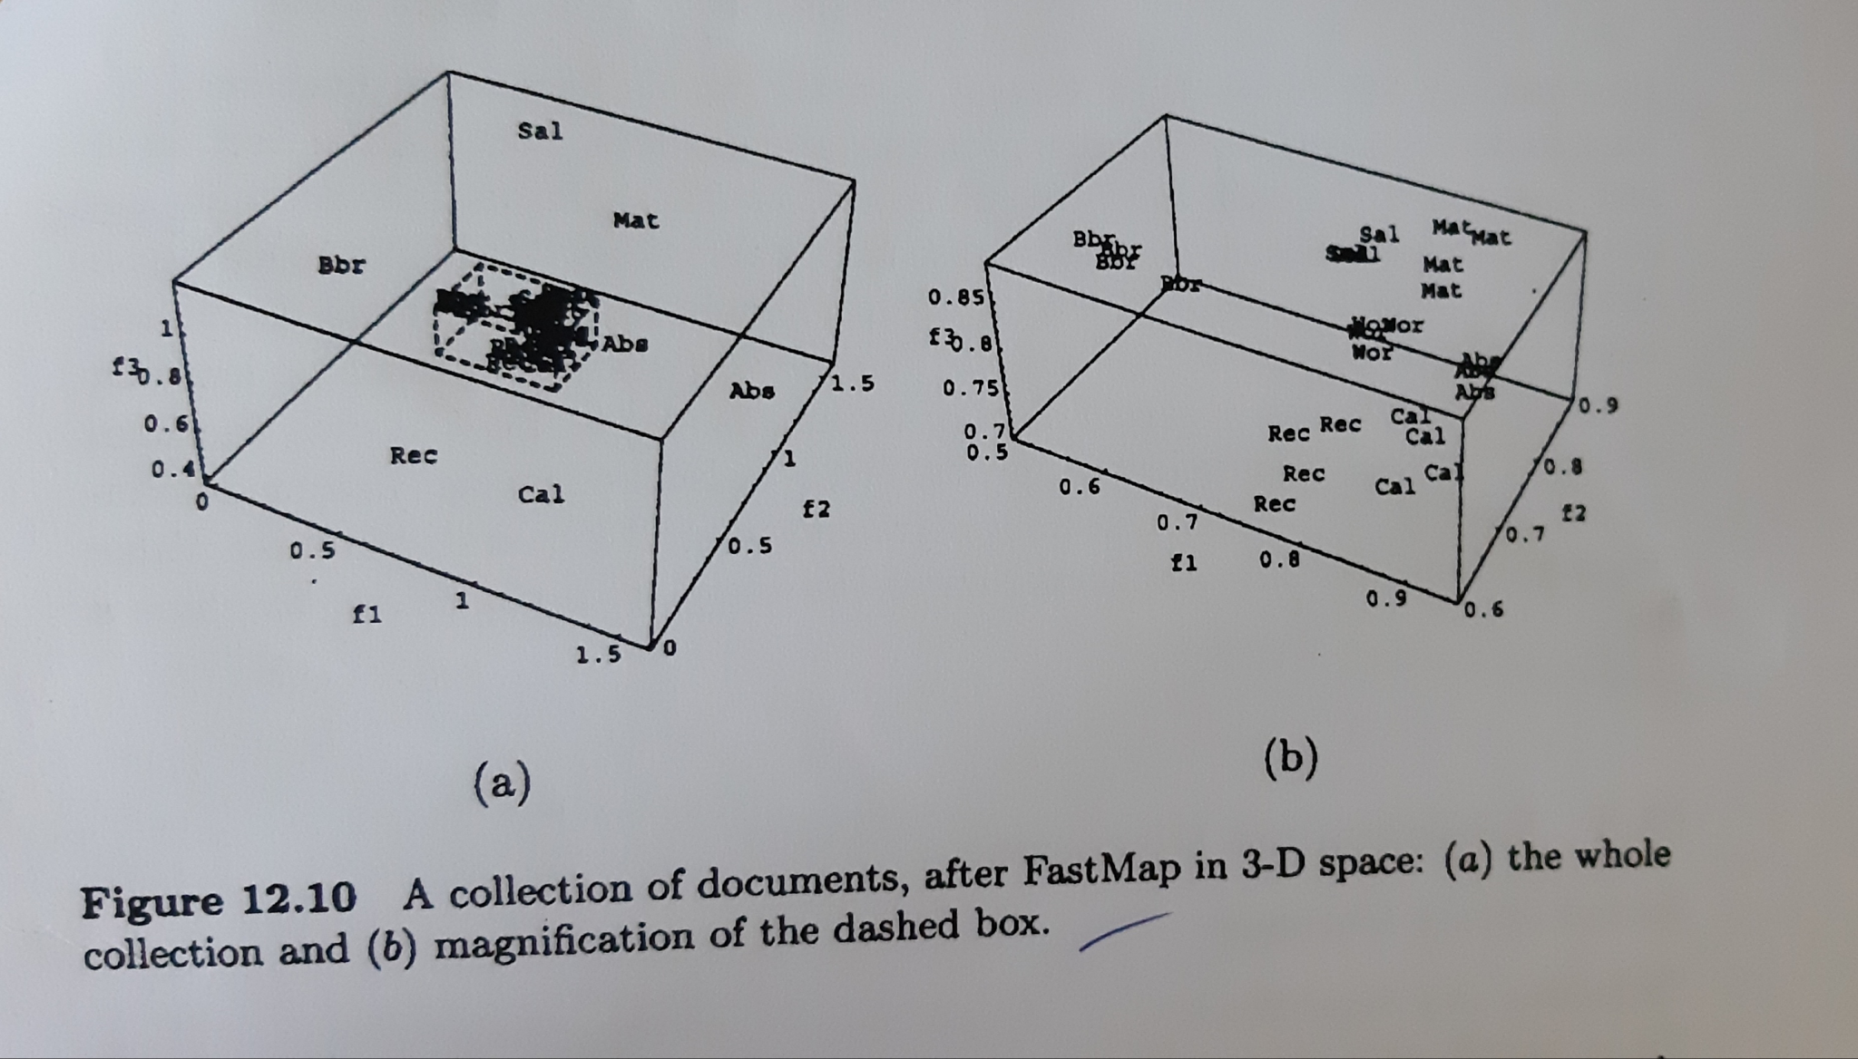

Slide 39
Searching the Web:
Challenges:
Distributed data
High percentage of volatile data
Large volume
Unstructured and redundant data
Quality of data
Heterogeneous data
Characterising the web:
Measuring the Web
Modelling the web

Slide 40
Search Engines:
Browsing:
Metasearchers:
Are the web servers that send a given query to several search engines, web directories and other databases, collect the answers and unify them.
Searching using Hyperlinks:

